Slide 1
SECURE DATA HIDING IN IMAGE USING Steganography
CAPSTONE PROJECT
Presented By
Student Name : I. SUDHAKAR
College Name : KAKINADA INSTITUTE OF ENGINEERING AND TECHNOLOGY Department : CYBER SECURITY

Slide 2
OUTLINE
Problem Statement
Technology used
Wow factor
End users
Result
Git-hub Link
Conclusion
Future scope

Slide 3
Problem Statement
The digital landscape demands secure data transmission. Traditional encryption methods are easily detectable and vulnerable to attacks. Steganography offers a covert solution by hiding data within seemingly harmless images. Existing steganographic techniques often struggle to achieve a balance between data capacity, imperceptibility, and robustness. The need for improved methods that enhance security while remaining undetectable is paramount. This project aims to develop a novel steganographic approach that effectively addresses these challenges, providing a more secure and reliable solution for transmitting sensitive information.

Slide 4
Technology used
Python Programming language has been used for writing the code.
CV2, OS, String are the import libraries that are used for the program to work.
Visual Studio Code is the environment used to execute the program.

Slide 5
Wow factors
Like in every cryptography technique, the Steganography is also used to hide the original message from the unauthorised person and used a key to hide the message.
But the WOW factor in the steganography is, here the message(plain text or the original message) is hidden in an image without effecting the extension of the file too.
So it makes it difficult for somebody to guess that the data is stored in the image.
Even if he knows that, again he would require the key to decrypt the image to get the original required data, which makes it difficult to get the original message
This makes this secure from disclosure of the message to a non legitimate person.
In this project Python programming language is used to implement the Steganography, which makes it very easy to write the code than any other programming language.

Slide 6
End users
There is a use of this technique where ever there is a need of transmission of confidential data from a person(sender) to another person(receiver). Therefore, some examples of the end-users who would use steganography are:
Healthcare
Finance
Government Agencies
Legal
Businesses
Education
Research

Slide 7
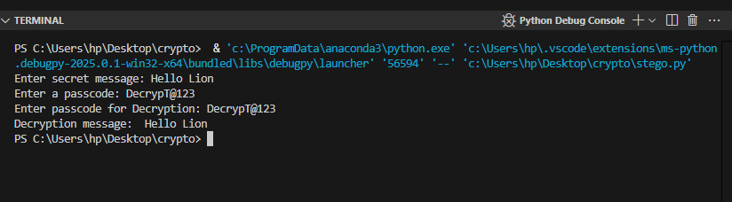
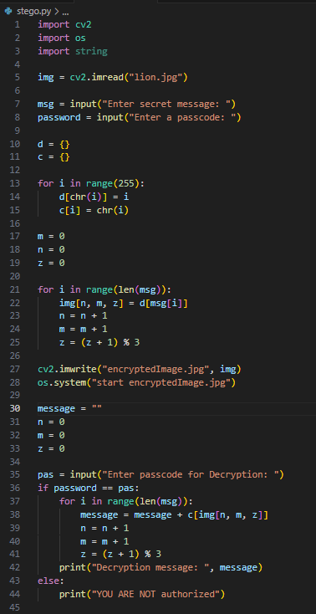
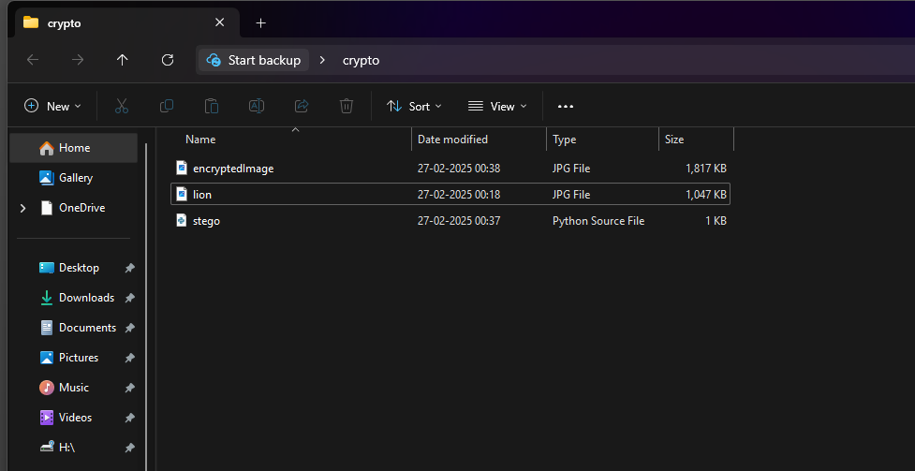
Results

Slide 8
GitHub Link
You can access all the required resources for this project in the below link
https://github.com/sudhakarhack/Stegonography.git

Slide 9
Conclusion
In conclusion, the development of a novel steganographic approach presents a significant opportunity to enhance the security and reliability of data transmission in the digital landscape. By addressing the limitations of existing techniques, this project aims to achieve a balance between data capacity, imperceptibility, and robustness, providing a more secure and covert solution for transmitting sensitive information. The future scope of this project holds immense potential for further advancements in steganography, exploring new embedding techniques, enhancing resistance against sophisticated attacks, investigating diverse applications, and developing a comprehensive framework for practical implementation. This research has the potential to contribute significantly to the field of secure communication and data protection in an increasingly interconnected world.

Slide 10
Future scope
Advance embedding techniques: Explore novel embedding algorithms, image transformations, or deep learning models to further enhance data capacity, imperceptibility, or robustness. Robustness against sophisticated attacks: Develop strategies to counter advanced steganalysis techniques by incorporating adaptive embedding strategies, multi-layered security, or utilizing robust image features for embedding. Broader applications: Investigate the potential of the developed approach in diverse domains like digital watermarking, copyright protection, or secure communication in specialized environments. Comprehensive framework development: Integrate the steganographic approach into a comprehensive framework encompassing tools for encoding, embedding, extraction, and security analysis, creating a user-friendly and versatile solution for practical applications.

Slide 11
THANK YOU

